Slide 1
Citi Bike Data Analysis
By Edike Chimdiebere Stanley

Slide 2
Project Goal:
To better understand the behavior of Citi Bike’s customer base (both one-time users and subscribers) and how they use Citi Bikes
This will help us to:
Identify where more bikes should be installed
Create targeted marketing campaigns that will appeal to different customer segments

Slide 3
Key questions:
What are the most popular pick-up locations across the city for Citi Bike rental?
How does the average trip duration vary across different age groups?
Which age group rents the most bikes?
How does bike rental vary across the two user groups (one-time users vs long-term subscribers) on different days of the week?
Does the factor of user age impact the average bike trip duration?

Slide 4
Findings & Insights

Slide 5
What are the most popular Citi Bike pick-up locations?
Start Station Name
Count
Grove St PATH
2115
Exchange Place
1224
Sip Ave
1084
Hamilton Park
1069
Morris Canal
710
Newport PATH
651
City Hall
576
Van Vorst Park
530
Newark Ave
510
Warren St
481
Brunswick St
472
Dixon Mills
470
Jersey & 6th St
462
Jersey & 3rd
455
Marin Light Rail
452
Paulus Hook
431
Brunswick & 6th
394
Monmouth and 6th
388
Essex Light Rail
383
McGinley Square
381
Newport Pkwy
342
Oakland Ave
331
Columbus Drive
329
Liberty Light Rail
303
Manila & 1st
229
JC Medical Center
222
Baldwin at Montgomery
197
Pershing Field
163
5 Corners Library
146
Astor Place
134
Christ Hospital
122
Hilltop
122
Lincoln Park
119
Lafayette Park
116
Central Ave
114
Heights Elevator
91
Riverview Park
77
North St
74
Dey St
68
Garfield Ave Station
66
Leonard Gordon Park
44
NJCU
43
Communipaw & Berry Lane
42
West Side Light Rail
31
Columbia Park
25
Union St
24
Danforth Light Rail
15
MLK Light Rail
11
Bayside Park
3
Bethune Center
2

Slide 6
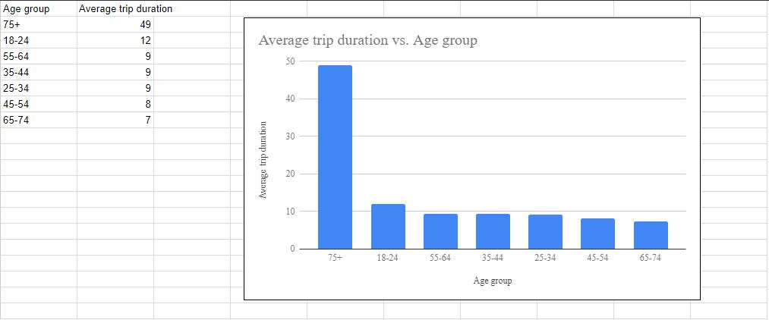
2. How does the average trip duration vary across different age groups?
The graph above shows average trip duration across different age, we can see that at age 75+ has a trip duration of 0-49 and so on.

Slide 7
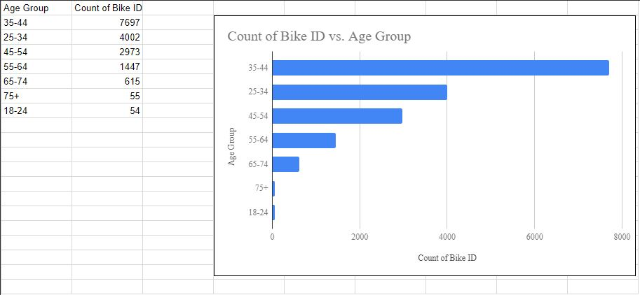
3. Which age group rents the most bikes?
From the graph above, we can see the age group that rents the most bikes are the ages between 35-44.

Slide 8
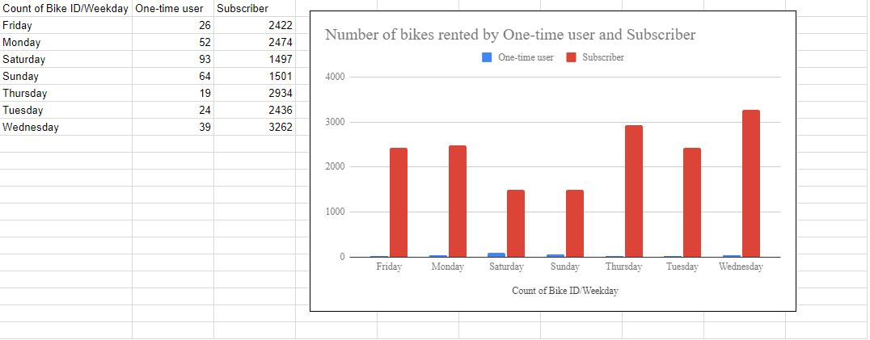
4. How does bike rental vary across the two user groups (one-time users vs long-term subscribers) on different days of the week?
In the graph above, it shows the variation across the two user group (one-time users vs long-term subscribers)where there is 26 one-time user on Friday with 2422 subscribers and so on.

Slide 9
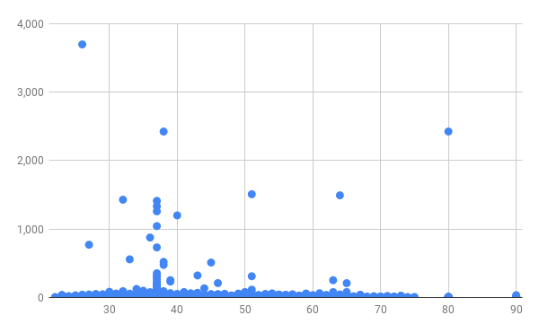
5. Do factors like weather and age impact the average bike trip duration?
Factors like weather and age does impact the average bike trip. As stated in the graph above, at age between 30-40 we see weather impact on the trip duration.

Slide 10
Summary

Slide 11
Summary of findings:
Top 5 pick-up locations for bikes:
Grove St Path, Exchange Place, Sip Ave, Hamilton Park, & Morris Canal
Customer base:
In Grove st path, bikes should be more installed in that location hence the usage/rents is in high rate for people within the ages of 35-44 with bike count 7697
Citi Bike customer behavior:
Wednesday users takes the longest trip on average
Saturday users takes the shortest trip on average

Slide 12
Actions & Recommendations

Slide 13
Recommended actions:
Product recommendations:
Install more bikes at https://citibikenyc.com (New york citi bike)
Marketing recommendations:
The Citi Bike customer base is mostly subscribe, aged between...35-44, who are most active weekday. This tells us that they are probably people who live in New York and use Citi Bikes to commute. Marketing and advertising campaigns should therefore target this particular demographic.

Slide 14
Thank you!

